Slide 1
Ballyleague National School Enrolment 2024/2025 Open Evening Monday, 29th January 2024 from 3:15 to 4:15 All new entrants invited to attend
If unable to attend the Admission Form is available to download from
School Website: www.ballyleaguens.com
Or request by  043 3321906 or by email  ballyleaguens@gmail.com

Slide 2
Gymnastics Workshop

Slide 3
World Cup Rugby Blitz

Slide 4
Visit to Atlantaquaria, Galway

Slide 5
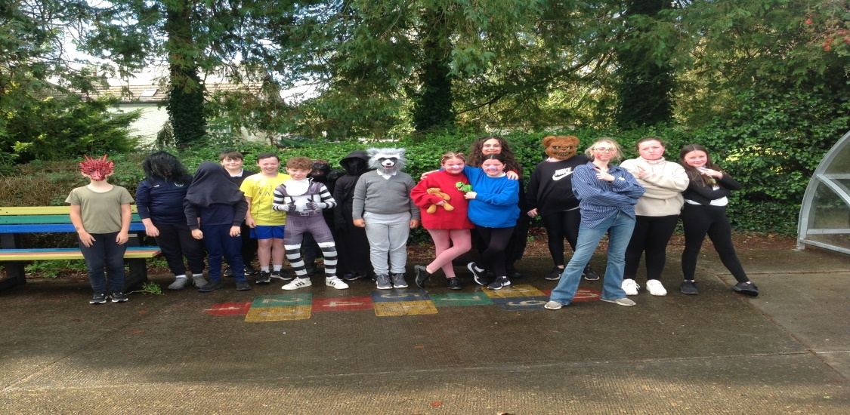
Hallowe’en Dress Up

Slide 6
Goal Jersey Day

Slide 7
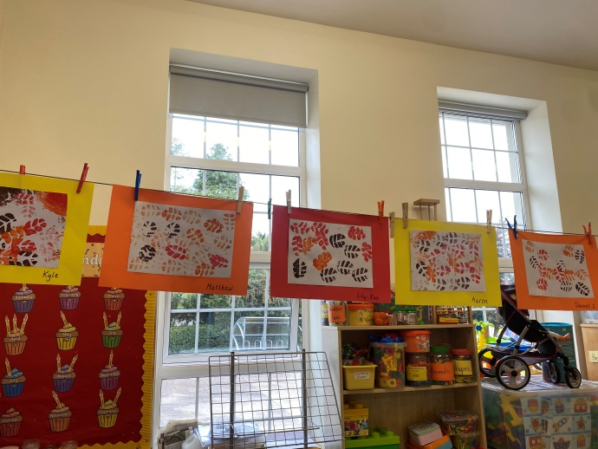
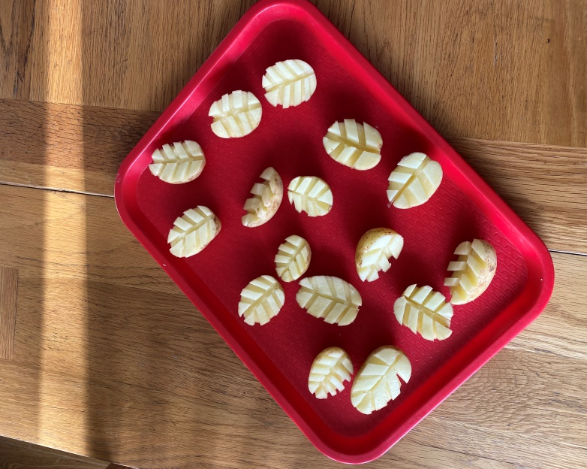
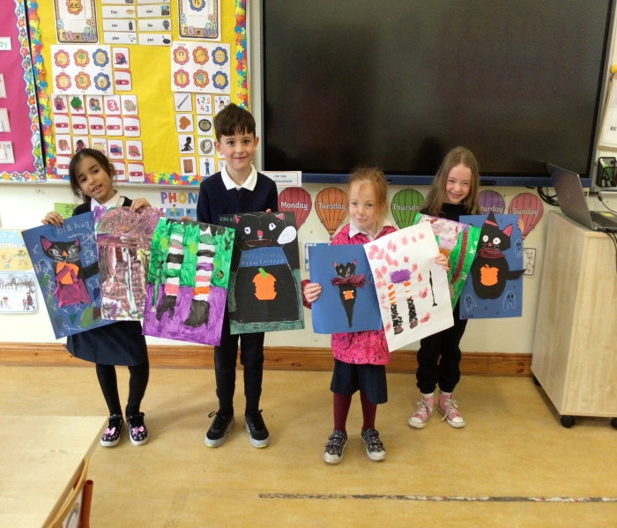
Art Work

Slide 8
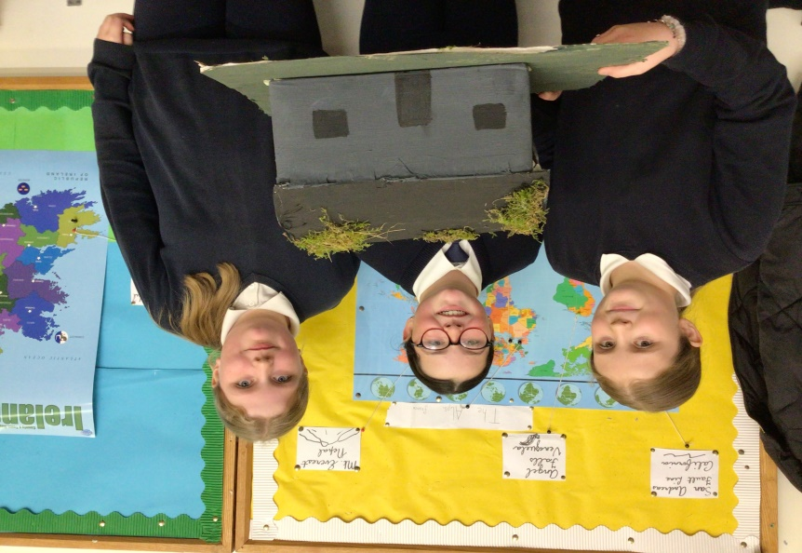
An Gorta Mór Project

Slide 9
Drumming Workshop

